Slide 1
Whole blood pathogen inactivation in Ghana
Budget impact and risk assessment
W Alton Russell^{1, 2}, Shirley Owusu-Ofori³, Alex Owusu-Ofori^{3, 4}, Betty Norman^{3, 4}, Eileen Micah^{3, 4}, Brian Custer^{2, 5}
¹Stanford University, Stanford, United States
²Vitalant Research Institute, San Francisco, United States
³Komfo Anokye Teaching Hospital, Kumasi, Ghana
⁴Kwame Nkrumah University of Science and Technology, Kumasi, Ghana
⁵University of California San Francisco, San Francisco, United States
Presented at the 36th International Congress of the ISBT
Notes:
Thank you to the ISBT for organizing this meeting. My name is Alton Russell, and today I will be presenting a health-economic study estimating the impact of whole blood pathogen inactivation in Ghana.

Slide 2
Conflicts of Interest
I have received consulting fees from Terumo BCT in conjunction with this work.

Slide 3
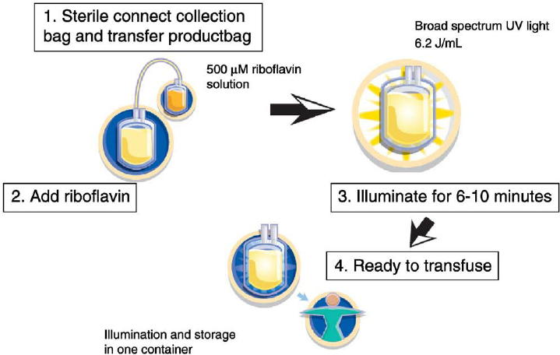
Background
Sub-Saharan Africa has highest rates of HIV and malaria infection in the world¹
Pathogen inactivation promising technology for Sub-Saharan Africa²
No published health-economic assessment for Sub-Saharan Africa
Reddy et. al. 2008 Transfusion Medicine Reviews
1. Global Status Report on Blood Safety and Availability, WHO, 2016
2. Ware et. al. 2018, Vox Sang.
Notes:
Sub-Saharan Africa has the highest rate of HIV and malaria infection in the world. Incidence of transfusion-related adverse events is higher when compared to western countries.
Pathogen inactivation is a technology that reduces the risk of transfusion-related adverse events using an additive, such as riboflavin, and UV light.
It is considered a promising technology, particularly for SSA. However, no health-economic assessments have been published.

Slide 4
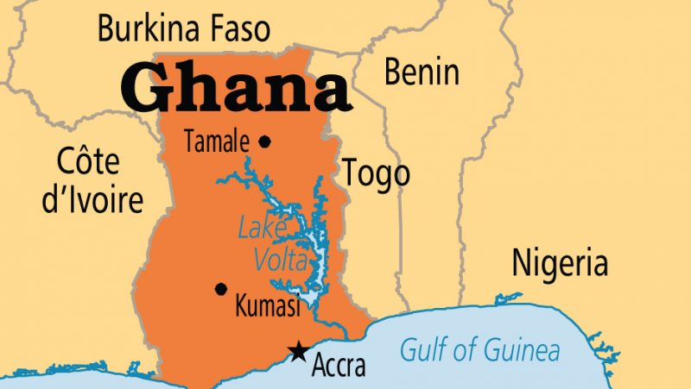

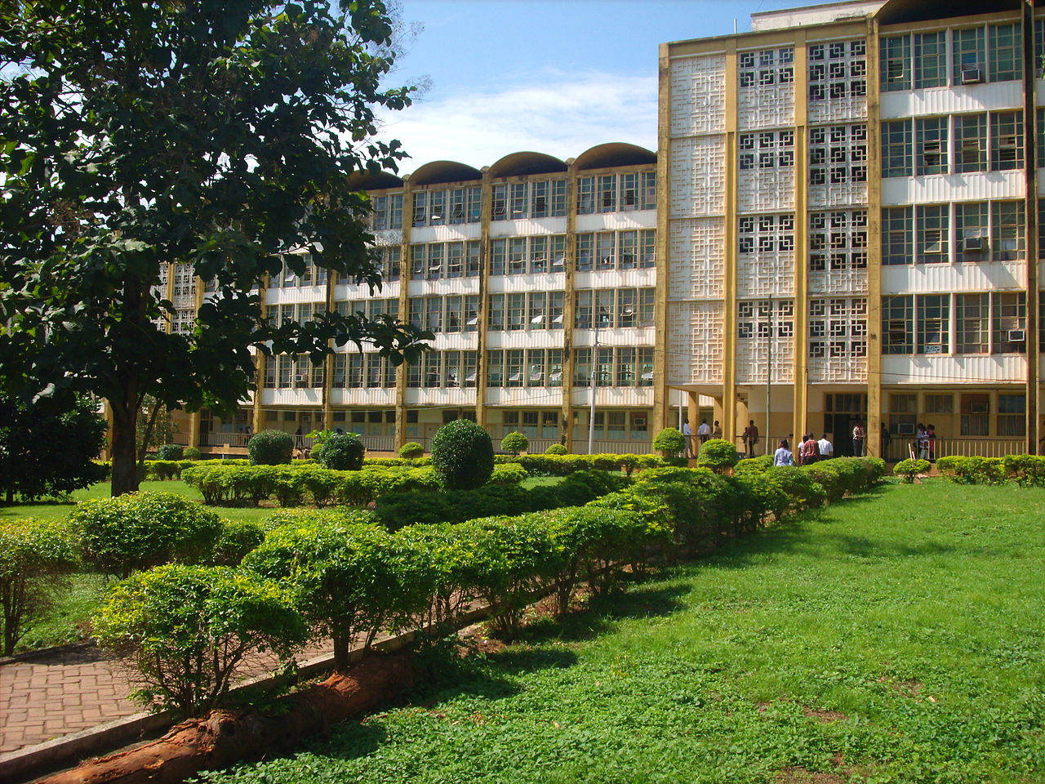

Blood safety in Ghana
Whole blood transfusion is primary blood product
Donations screened for HIV-1/2 , hepatitis C, HBsAg, and syphilis
AIMS study: ~6-fold reduction in transfusion-transmitted malaria when whole blood pathogen inactivation used¹
1. Allain et. al. 2016 The Lancet
Notes:
Our analysis focused on Ghana.
Like many SSA countries, whole blood transfusion is much more common that transfusion of components.
Donations are routinely screened for HIV-1/2 , hepatitis C, HBsAg, and syphilis using rapid tests
A recent study in Ghana estimated the impact of whole blood pathogen inactivation on TT-malaria. That study found that PI led to a 6 fold reduction in the rate of transfusion-transmitted malaria

Slide 5
Objective
Estimate how the addition of whole blood pathogen inactivation to the existing blood safety program in Ghana would impact:
Incidence of transfusion-related adverse outcomes
Net healthcare spending
Cost of implementing pathogen inactivation
Savings due to averted transfusion related adverse events

Slide 6
Methods
Decision-analytic model in Microsoft Excel
Estimated the number of adverse events with and without pathogen inactivation and associated healthcare costs
Outcome uncertainty estimated through probabilistic sensitivity analysis
7 adverse outcomes:
HIV
Hepatitis B (HBV)
Hepatitis C (HCV)
Syphilis
Bacterial sepsis
Malaria
Febrile non-hemolytic transfusion reactions (FNHTRs)

Slide 7
Blood system parameters
Blood system parameters: | Point estimate | Min | Max | Distribution
Number of whole blood units transfused¹ | 160,295 | 128236 | 192354 | Triangular
Percent donations not transfused (Waste)² | 9% | 0.01 | 0.17 | Triangular
Cost of PI per treatment (USD$)³ | 46 | 36.8 | 55.2 | Triangular
Number of donations per transfusion recipient⁴ | 1.9 | 1.5 | 2.3 | Triangular
Based on WHO report
Data from local transfusion service
Provided by manufacturer (Terumo BCT)
Based on AIMS trial

Slide 8
Exposure risk without pathogen inactivation
Baseline residual risk: | Point estimate | Min | Max | Distribution
HIV | 0.00112 | 0.00036 | 0.00324 | Triangular
HCV | 0.00540 | 0.00135 | 0.01216 | Triangular
HBV | 0.00940 | 0.00235 | 0.02116 | Triangular
Syphilis | 0.00064 | 0.00034 | 0.00092 | Triangular
Sepsis | 0.13000 | 0.07557 | 0.18586 | β(24, 168)
Malaria | 0.25000 | 0.198 | 0.302 | β(91, 276)
Febrile non-hemolytic transfusion reaction | 0.03168 | 0.01596 | 0.05980 | Triangular
Based on published estimates or unpublished hemovigilance data
Assumes donations screened for HIV-1/2 , hepatitis C, HBsAg, and syphilis

Slide 9
Risk of symptomatic adverse outcome
Symptomatic outcome risk | Point estimate | Min | Max | Distribution
HIV | 0.983 | 0.5 | 1 | Triangular
Sepsis | 1 | 0.5 | 1 | Triangular
HCV | 1 | 0.5 | 1 | Triangular
HBV | 0.552 | 0.4 | 0.7 | Triangular
Syphilis | 0.57 | 0 | 1 | Triangular
Malaria | 0.185 | 0.084 | 0.337 | Triangular
Febrile non-hemolytic transfusion reaction | 1 | - | - | -
HIV prevalence and HBV vaccination rate considered
Assumes syphilis transmission occurs in units stored < 4 days
Malaria risk calculated based on AIMS study data
Notes:
Not all infectious donations lead to a symptomatic outcome in recipients.

Slide 10
Impact of pathogen inactivation
Fold risk reduction of whole blood pathogen Inactivation | Point estimate | Min | Max | Distribution
HIV¹ | 10 | 5 | 20 | Triangular
Sepsis¹ | 25 | 10 | 40 | Triangular
HCV¹ | 10 | 5 | 20 | Triangular
HBV¹ | 10 | 5 | 20 | Triangular
Syphilis¹ | 20 | 10 | 40 | Triangular
Malaria² | 6.054 | 1 | 20 | Triangular
Febrile non-hemolytic transfusion reaction³ | 1.5 | 1 | 3 | Triangular
Based on estimates from prior modeling studies
Based on AIMS randomized trial
Based on retrospective study of platelet pathogen inactivation

Slide 11
Cost estimation for acute adverse events
Costs for acute diseases calculated using micro-costing from data provided by clinicians at Komfo Anokye Teaching Hospital (KATH)
Assumed that all symptomatic adverse receive treatment
Sepsis | Estimate | Min | Max
Cost of additional hospitalization days | $60.00 | $40.00 | $80.00
Number of additional hospitalization days | 6 | 4 | 8
Cost of medication | $372.00 | $300.00 | $1,000.00
Probability of receiving medication | 90% | 80% | 100%
Average total cost | $694.80 | $400.00 | $1,640.00
Other acute adverse events | Total cost | Min | Max
Syphilis | $60.00 | $40.00 | $80.00
Malaria | $28.50 | $9.40 | $63.40
Febrile non-hemolytic transfusion reaction | $85.00 | $36.00 | $174.00

Slide 12
Cost estimation for chronic viral infections
Chronic viral infection | Total cost | Min | Max
HIV | $508.76 | $307.96 | $688.45
Hepatitis B | $537 | $377.1 | $1257
Hepatitis C | $592 | $427 | $1325
Estimates provided by clinicians at Komfo Anokye Teaching Hospital (HIV cost informed by recent costing study)¹
Future costs discounted to present at 3%
Plan to update with detailed disease state transition modeling
1. Mikkelsen et. al. 2017 AIDS
Notes:
These estimates are not based on detailed modeling of how patients transition between different health states after infection. We are developing state transition models that we plan to use to estimate costs but those are not yet ready to share publicly.

Slide 13
Impact of pathogen inactivation in Ghana
Adverse events prevented per year by whole blood PI:
19,600
(95% CI 15,200 – 28,800)
Annual healthcare savings from prevented adverse events:
USD $8.2 million
(95% CI $5.4 – $16.8 million)
Annual net savings from implementing whole blood PI:
USD $0.2 million
(95% CI -$2.6 – $8.9 million)

Slide 14
Probabilistic sensitivity analysis results
Net savings below $0 in 27% of iterations
Notes:
In probabilistic sensitivity analysis, pathogen inactivation had positive net savings (meaning the savings from averted adverse events exceeded the cost of PI) 73% of the time.

Slide 15
Sensitivity of net savings to parameters
Notes:
We also looked at how sensitive our findings were to uncertainty in our input parameters. You’ll recall that for each input parameter, we defined a range of values we think the parameter is likely to take. What we’ve done varied each of the parameters one at a time along that range and observed the effect on our outcome of interest: the net savings of pathogen inactivation.
The net savings of pathogen inactivation was sensitive to several variables: For example, if the cost of treating sepsis is on the low end of our estimate, the net savings could be only $300,000 a year, and on the high end net savings could be nearly $13 million.
Click
However, we did not find that any

Slide 16
Limitations
Factor not considered | Possible bias
Other adverse events (including emerging diseases) | Underestimate benefit
Secondary transmission (e.g., sexual partners) | Underestimate benefit
Non-medical costs (transport, productivity loss) | Underestimate benefit
Untreated adverse events | Overestimate benefit
Capital costs of pathogen inactivation | Underestimate cost
Detailed disease progression of chronic viral infections | Either direction
Notes:
Our study had several limitations:
We considered 7 major adverse events, but pathogen inactivation can also prevent other adverse outcomes, including emerging diseases.
We did not consider healthcare costs due to secondary infections, for example, if a transfusion recipient transmits HIV to a se
By not considering these factors we could be underestimating the benefit of PI
We also assumed recipeints received treatments for adverse events, when in fact some may not receive treatment due to unaffordability or other reasons. If many people are not receiving treatment for adverse events then we could be overestimating the net savings of PI.
We also did not factor in capital costs of pathogen inactivation such as equipment purchases,
And we have not yet implemented our planed more detailed modeling of disease progression for the chronic viral infections

Slide 17
Conclusion
Pathogen inactivation is likely to be cost-saving in Ghana from a healthcare payer perspective, assuming adverse events are treated
85% of savings due to averting sepsis infections

Slide 18


Thank you
Collaborators
Shirley Owusu-Ofori
Alex Owusu-Ofori
Betty Norman
Eileen Micah
Brian Custer
Support
Terumo BCT
Alton Russell
altonr@stanford.edu
@altonrus on twitter
Notes:
I’d like to thank my collaborators, Dr. Shirley and Alex Owusu-Ofori, Dr. Betty Norman, and Dr. Eileen Micah in Ghana, along with Dr. Brian Custer at Vitalant Research Institute. Thank you for your attention.

